Slide 1

MongoDB
Vinay Joshi
Department of
Computer Science and Engineering

Slide 2

MongoDB
File Based Systems
Program defines and manages it’s own data Limitations:
Separation and isolation
Duplication
Program & data dependence
Fixed queries
Proliferation of application programs

Slide 3
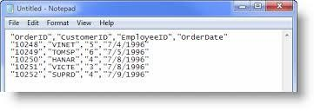
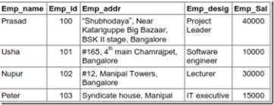
MongoDB
File Based Systems
File (Typically a CSV file)
Database

Slide 4
MongoDB Introduction
Name comes from “Humongous” & huge data
Written in C++, developed in 2009
Creator: 10gen, former doublick
Definition: MongoDB is an open source, document-oriented database designed with both scalability and developer agility in mind
Instead of storing your data in tables and rows as you would with a relational database, in MongoDB you store JSON-like documents with dynamic schemas (schema-free, schemaless)

Slide 5
MongoDB NoSQL Database
Stands for Not Only SQL??
Class of non-relational data storage systems
Usually do not require a fixed table schema nor do they use the concept of joins to derive data from different tables

Slide 6
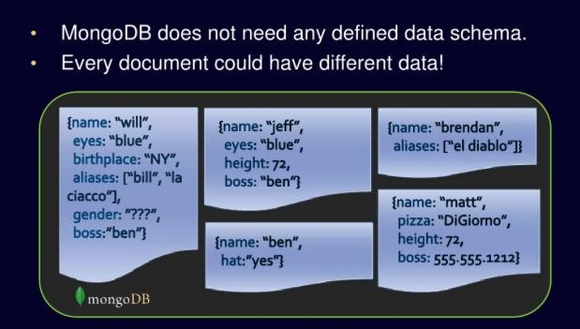
MongoDB
MongoDB – a NoSQL Database
No Defined Schema (Schema Free or Schema Less)

Slide 7
MongoDB
Terms Mapping (DB vs. MongoDB)
RDBMS | MongoDB
Database | Database
Table | Collection
Tuple/Row | Document
Column | Field
Table Join | Embedded Documents
Primary Key | Primary Key (Default _id key provided by mongodb)

Slide 8
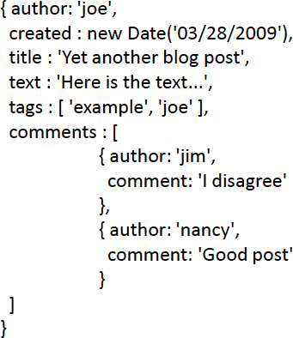
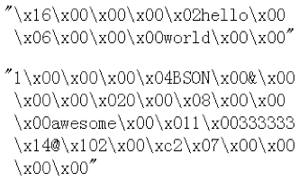

MongoDB
Data Model – BSON Format
BSON format (binary JSON)
Developers can easily map to modern object-oriented languages without a complicated ORM layer.
Remember it is stored in binary formats (BSON)

Slide 9
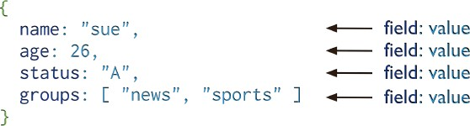
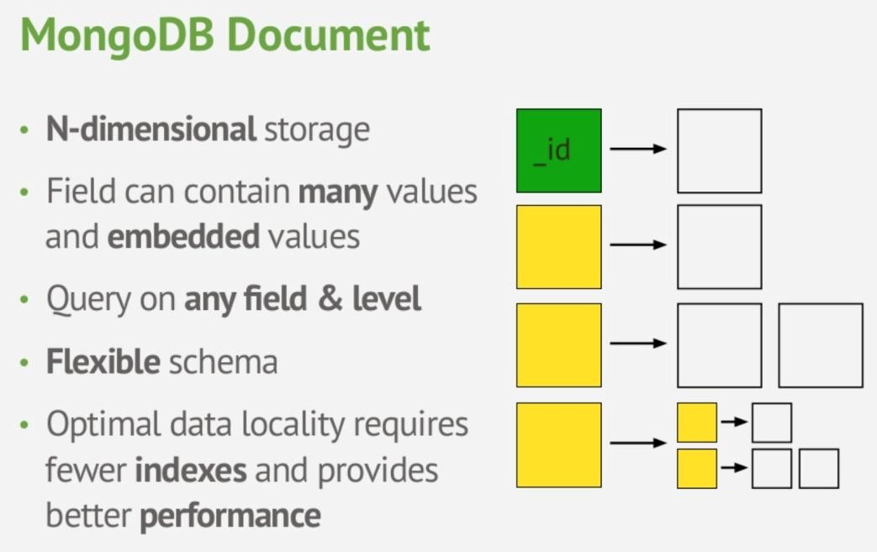
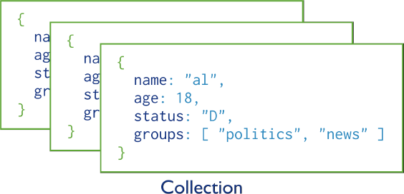
MongoDB
MongoDB Data Model
One document (e.g., one tuple in RDBMS)
Collection is a group of similar documents
Within a collection, each document must have a unique Id
One Collection (e.g., one Table in RDBMS)

Slide 10
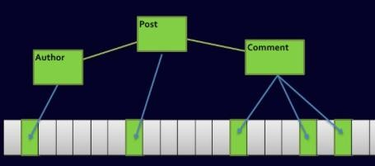

Complex Join Queries
MongoDB
Relational DBs
MongoDB

Slide 11



MongoDB
Getting Started…
Install it Practice simple stuff
Install it from here: http://www.mongodb.org
Move to complex stuff
Manual: http://docs.mongodb.org/master/MongoDB-manual.pdf (Focus on Ch. 3, 4 for now)
Dataset: http://docs.mongodb.org/manual/reference/bios-example-collection/

Slide 12
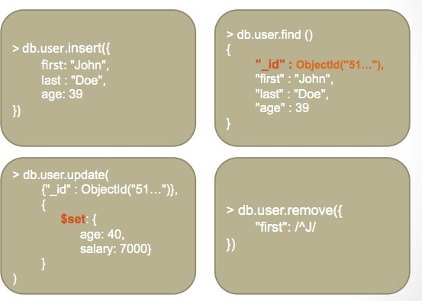
MongoDB
Data Operations
Create
db.collection.insert( <document> ) db.collection.save( <document> )
db.collection.update( <query>, <update>, { upsert: true } )
Read
db.collection.find( <query>, <projection> ) db.collection.findOne( <query>, <projection> )
Update
db.collection.update( <query>, <update>, <options> )
Delete
db.collection.remove( <query>, <justOne> )

Slide 13
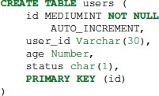

MongoDB
Example Operations – Creation and Deletion
In MongoDB
Either insert the 1st docuement
In RDBMS
Or create “Users” collection explicitly

Slide 14
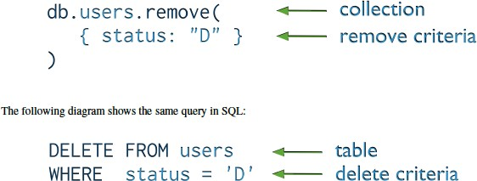

Example Operations – Removal or Deletion
MongoDB
You can put condition on any field in the document (even _id)
db.users.remove ( )
Removes all documents from users collection

Slide 15
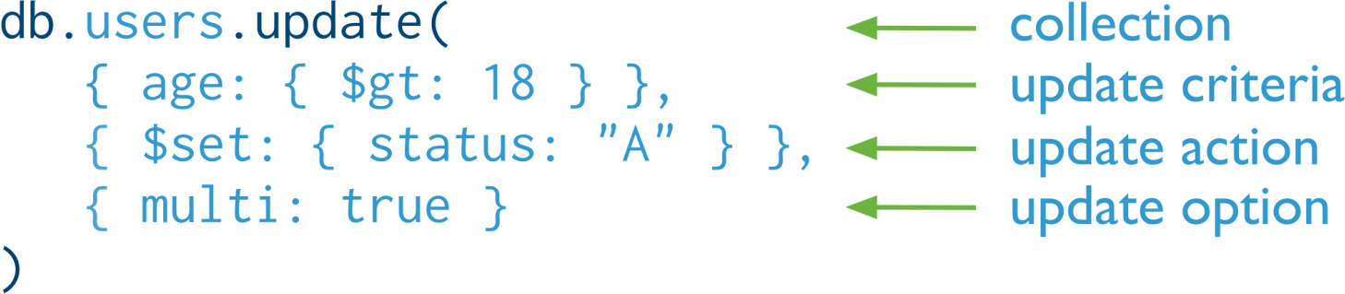

MongoDB
Example Operations – Update
Otherwise, it will update only the 1st matching document
Equivalent to in SQL:

Slide 16
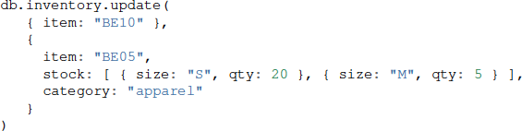
MongoDB
Example Operations – Replace a document
Query Condition
New
doc
For the document having item = “BE10”, replace it with the given document

Slide 17
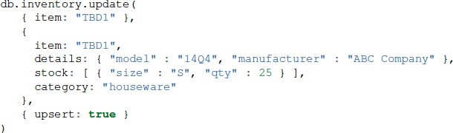
MongoDB
Example Operations – Insert or Update?
The upsert option
If the document having item = “TBD1” is in the DB, it will be replaced
Otherwise, it will be inserted.

Slide 18
NODE JS
Node JS and MongoDB Connectivity
Node.js can use this native module to manipulate MongoDB databases require(‘mongodb’);
Alternately, use more sophisticated third party module like ‘mongoose’ that provides Object Data Modeling capabilities
Creating a Database
To create a database in MongoDB, start by creating a MongoClient object, then specify a connection URL with the correct ip address and the name of the database.
MongoDB will create the database if it does not exist, and make a connection to it.

Slide 19
NODE JS
Node JS and MongoDB Connectivity
Creating a Collection
To create a collection in MongoDB, use the Collection() method
In MongoDB, a collection is not created until it gets content
Insert a single document Into Collection
To insert document into a collection, use the insertOne() method
A document in MongoDB is the same as a record in MySQL
The first parameter of the insertOne() method is an object containing the name(s) and value(s) of each field in the document you want to insert.
It also takes a callback function where you can work with any errors, or the result of
the insertion
To insert multiple documents at once, use insertMany() method

Slide 20
NODE JS
Node JS and MongoDB Connectivity
Select the documents from collection:
In MongoDB use the find() and findOne() methods to find data in a collection.
Just like the SELECT statement is used to find data in a table in a MySQL database.
Find:
To select data from a table in MongoDB, we can also use the find() method.
The find() method returns all occurrences in the selection.
The first parameter of the find() method is a query object.

Slide 21
THANK YOU
Vinay Joshi
Department of
Computer Science and Engineering
vinayj@pes.edu

